Slide 1
Amazon Sales Performance Analysis
Ahmed Ali Alarayedh

Slide 2

Why this project is undertaken
As e-commerce grows, the company struggles to pinpoint what drives sales, profits, and delivery issues. My role: analyse sales data and deliver clear, actionable insights.

Slide 3
The Challenges
“The main issue is the lack of clear insights into order patterns, customer demand, and fulfilment efficiency. This makes it difficult for the business to make smart decisions in marketing, inventory planning, and logistics. My goal was to turn this raw Amazon sales data into a story — one that reveals trends, pain points, and opportunities.”

Slide 4
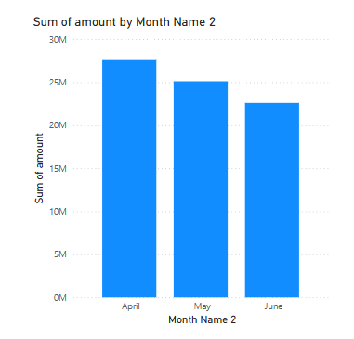
Revenue trends overview
I began by analysing total revenue across four months. April stood out with the highest revenue at 27.5M.However, sales declined — down 4.7% in May and 14.9% in June. This suggests possible seasonality or special sales events driving April’s spike.

Slide 5
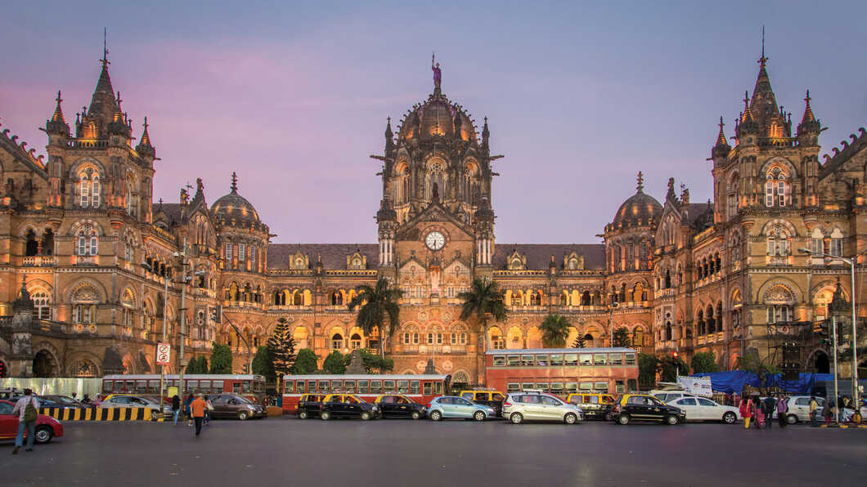
Maharashtra

Slide 6
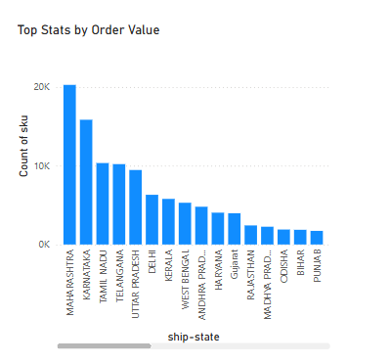
Top performance states
Next, I analysed sales by state. Maharashtra leads with the highest total SKU count and purchases. Visualizing this helps us identify key regional markets that the company can prioritize.

Slide 7
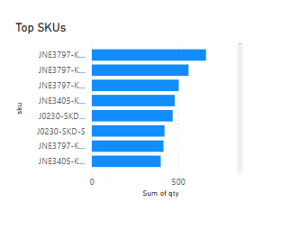
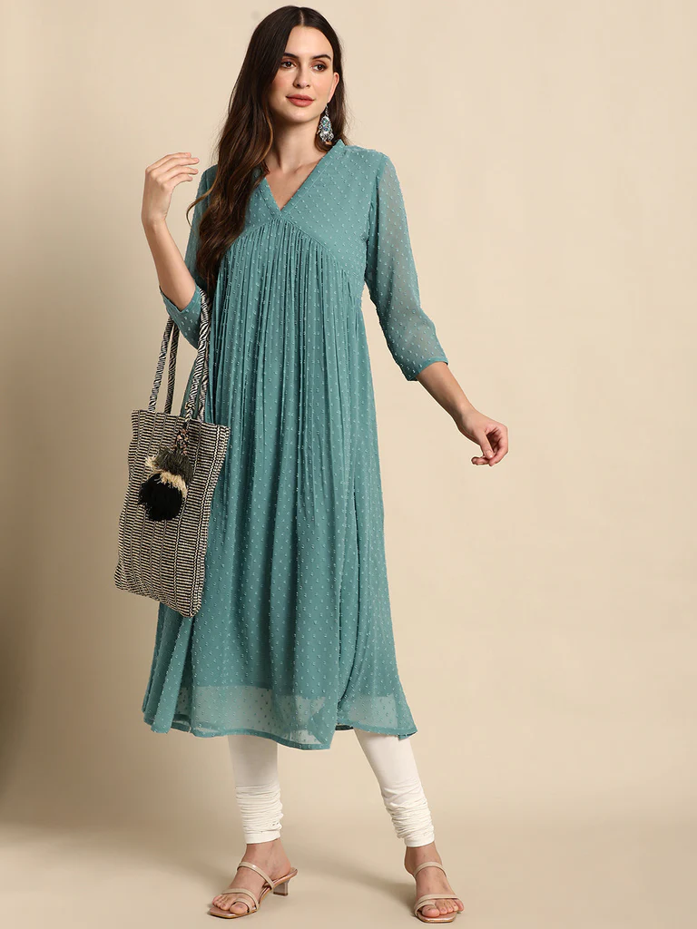
Top SKUs and Regional Demand
What Are Customers Buying? Without product names, I analysed SKUs. Top SKU: JNE3797-KR-L — a Western Dress, mostly sold in Maharashtra. Top categories: Sets (45K), Kurtas (44K), Western Dresses (14K).Visual shows what these SKUs represent.

Slide 8
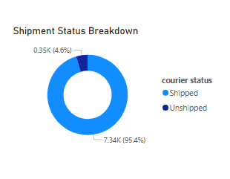
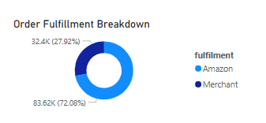
Delivery & Fulfilment Insights

Slide 9



Recommendations
Focus marketing campaigns in Maharashtra and other high-performing states.
Investigate April promotions to replicate successful sales events.
Highlight top product categories — Sets and Kurtas — in ads.
Encourage more sellers to use Amazon fulfilment for better delivery control.

Slide 10
Conclusion heighlight
✅ April recorded the highest revenue — 27.5 million.
👗 Top-selling product categories were Sets (45K+ units) and Kurtas (44K+ units).
📍 Maharashtra had the highest number of orders and SKUs.
🚚 Only 4.6% of orders are unshipped, indicating strong operations.
💸 Western Dresses rank third, with standout SKUs like "JNE3797 KR L."
📈 These insights help improve marketing, inventory planning, and delivery strategy.

Slide 11
Thank You

Slide 12


